Slide 1
EMAP – CAD Models
Date Prepared: August 7, 2020

Slide 2
Electro-Chem Cell CAD Models

Slide 3
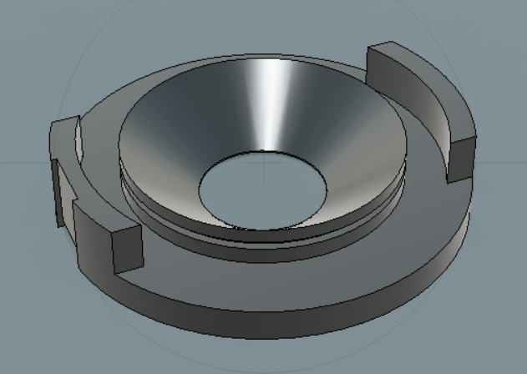
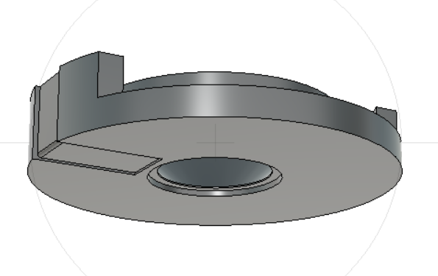
Bottom Casing CAD Model

Slide 4
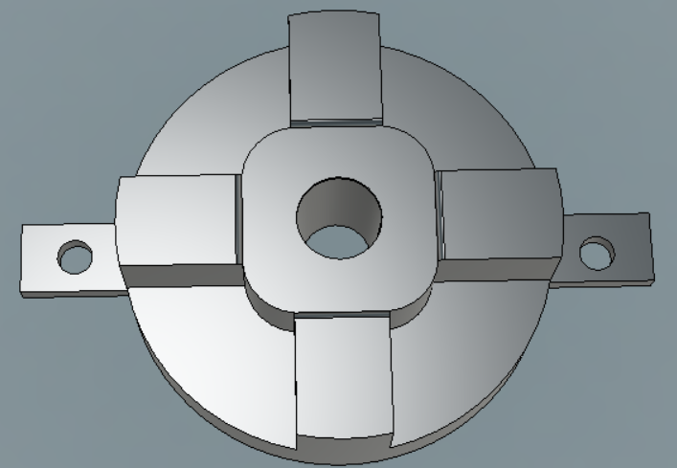
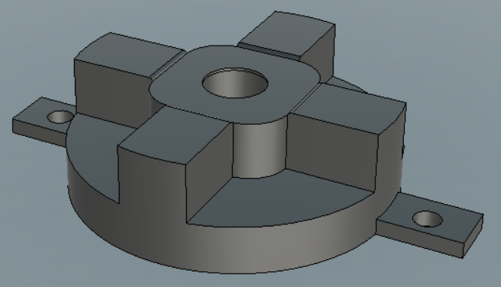
Sample Holder CAD Model

Slide 5
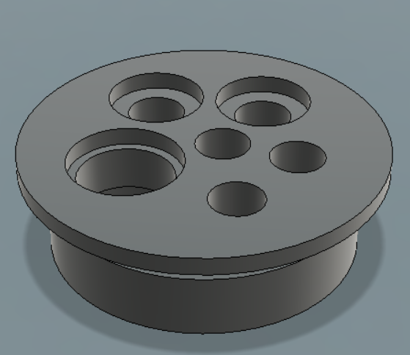
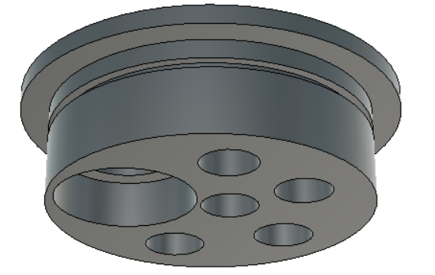
Cell Cap CAD Model

Slide 6
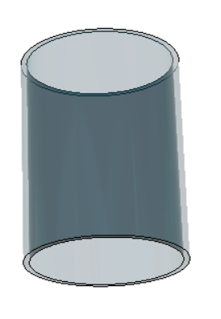
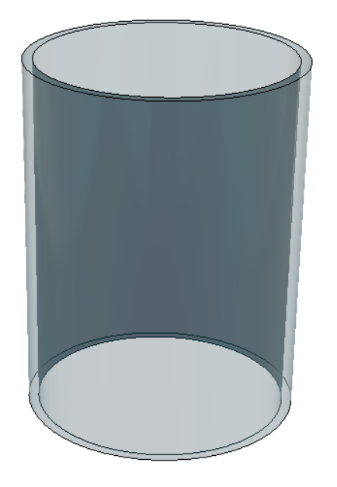
Glass Chamber CAD Model

Slide 7
Actuator Lift CAD Models

Slide 8
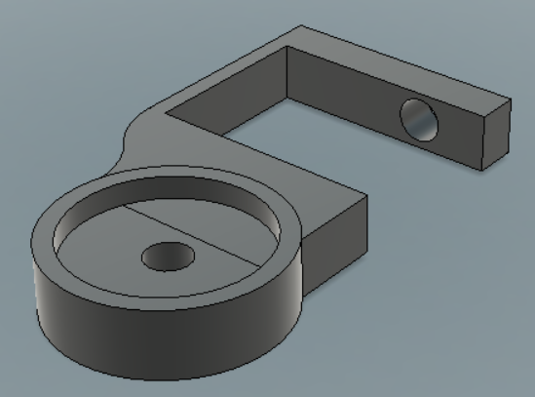
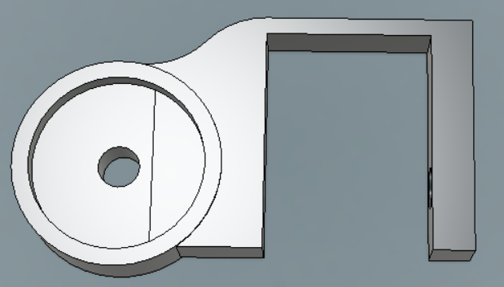
Stationary Pedestal CAD Model

Slide 9
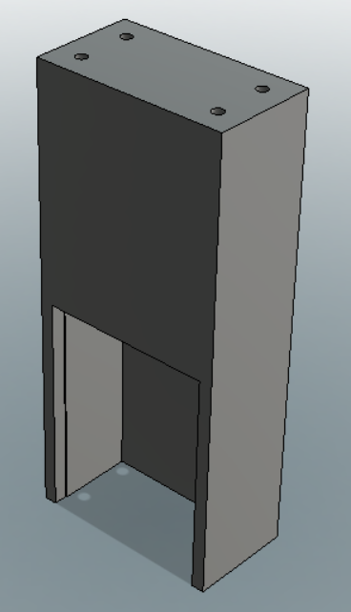
Pneumatic Actuator Body CAD Model

Slide 10
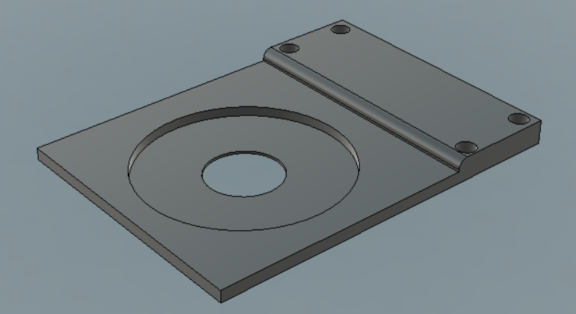
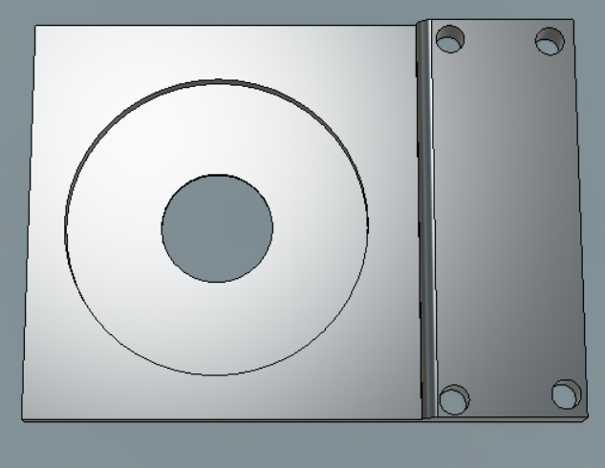
Actuator Lift Plate CAD Model

